Slide 1
Business Data Management Project
Title- Inventory Management in Kirana Stores
By – Devansh Rathi
21f10010002

Slide 2
BUSINESS IN BRIEF
Retailing includes all the activities involved in selling goods or services to the final customers for personal, non-business use.
India’s retail sector is highly unorganised with brick-and-mortar stores accounting for 88 % of the sector. It has more than thirteen million Kirana and neighbourhood stores .
The Indian retail is dotted by traditionally marketplaces called bazaars or haats comprises of numerous small and large shops, selling different or similar merchandise which together make up the unorganised retail sector.
Some of the major legacy challenges include inventory management, shop infrastructure and adoption to new technologies like digital payments etc.
Since the advent of E-commerce, the sector has become extremely competitive and Kirana businesses are losing customers

Slide 3
HOW THE DATA WAS COLLECTED?
Since kirana store is in a small shop in a tier-2 city no electronic record of sales was maintained.
Moreover the kirana store owner did not maintain any sales record and no book keeping was done.
Therefore the data was collected manually at the end of each day from the shopkeeper.
Sales data was entered manually into an excel sheet for a month.
The data was organised in a neat manner into categories so that data could be analysed according to the category of the products.

Slide 4
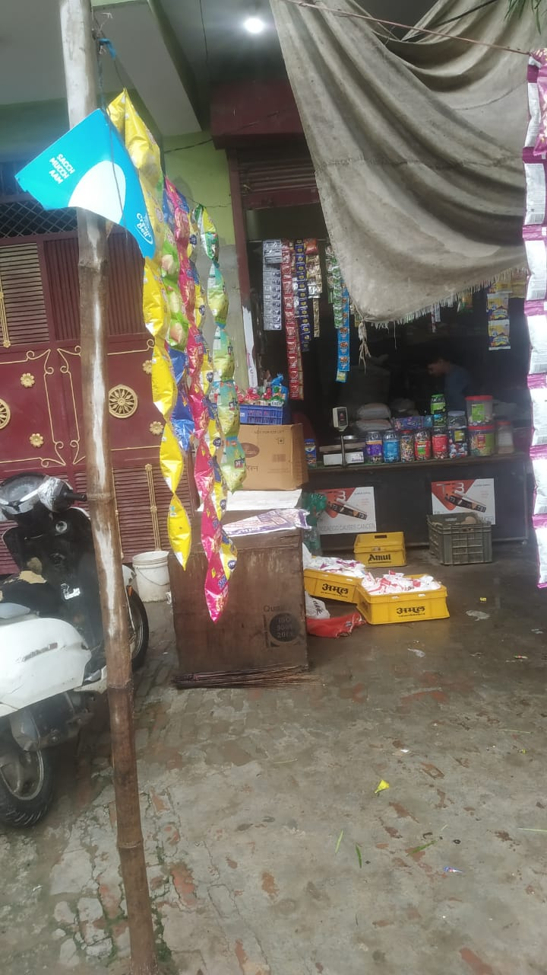
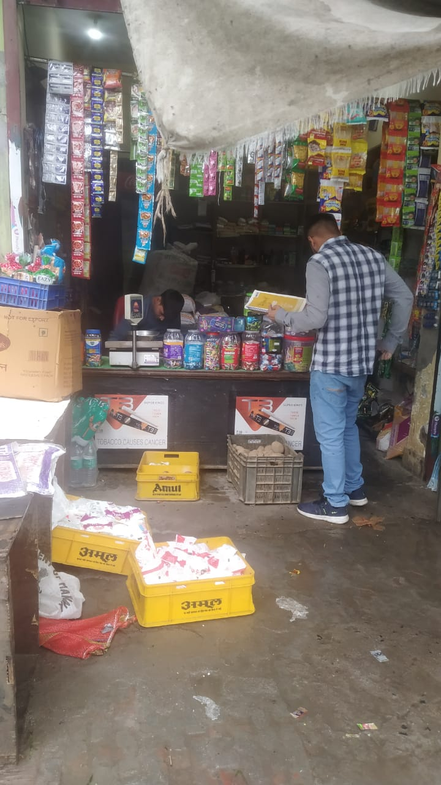
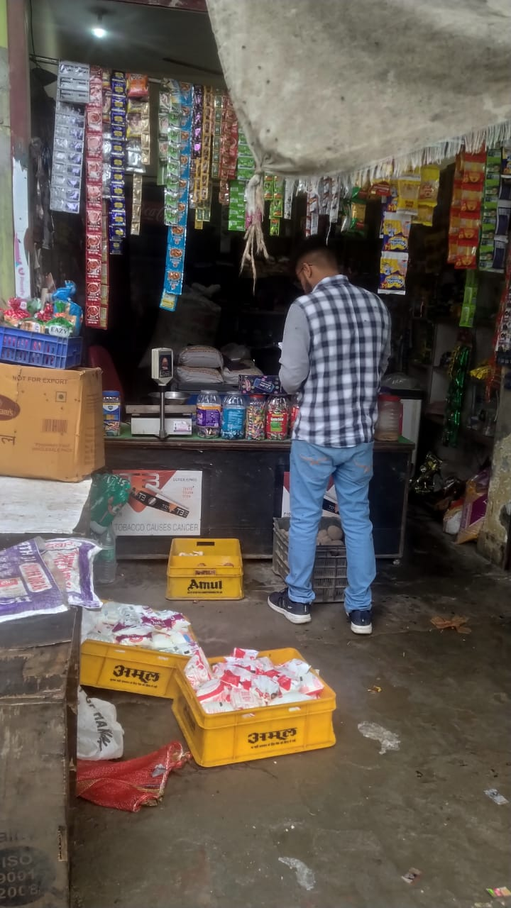

Slide 5
ANALYSIS AND INTERPRETATION
The approach involves first collecting the required monthly sales data, cleaning it, analyzing the data to find average monthly sales per category, top 5 products according to sales volume, top 5 products according to monthly revenue, top 5 products according to monthly profits.
Possessing a high amount of inventory for a long time is usually not a good idea. That's because of the challenges it presents, including storage costs, spoilage costs, and the threat of obsolescence.
We can utilize the data to map an inventory management plan to help the Kirana owner purchase in bulk increasing purchasing power and reducing cost price to the Kirana owner.

Slide 7
RECOMMENDATIONS GIVEN
The Kirana store should focus more on the categories that are driving our sales more and ensure proper inventory is maintained in those categories. Since winters are near the demand for dry fruits is also likely to increase in coming months.
For dairy products such as milk and curd which expire quickly, they should ensure daily replenishment of inventory and at the same time not keep excess inventory to prevent wastage.
These are items that are sold mostly in the first week of the month as monthly rations and hence the kirana store should keep a healthy stock at the beginning of the month and restock only near the end of the month.
According to the data weekends turn out to be highly engaging days in terms of sales and customer engagement. Buyers prefer weekends for shopping, and at weekends store earns higher profit rates than weekdays.Similarly, Festivals and national holidays also bring more customers. So, always make your Kirana store available with the updated inventory and essential items at the weekends to maximise the sales and profit margins.
Also, Kirana stores offer small credits to multiple individuals making it difficult to keep track of them. Using digital payments and bookkeeping more frequently can help in managing and tracking credits.

Slide 8
THANK YOU

